Slide 1
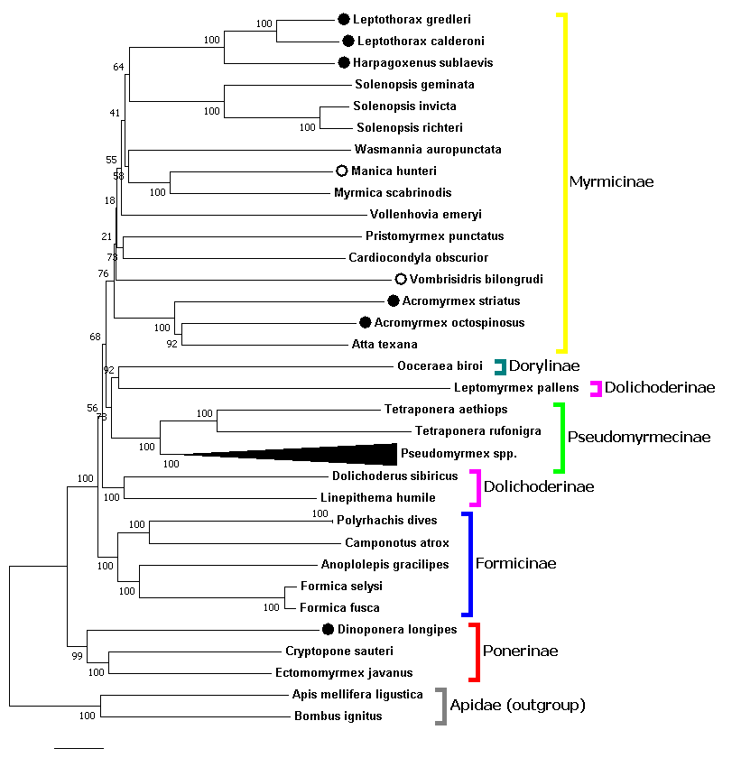
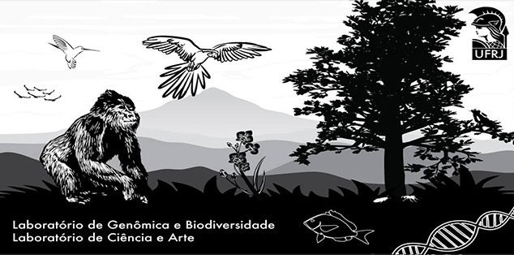



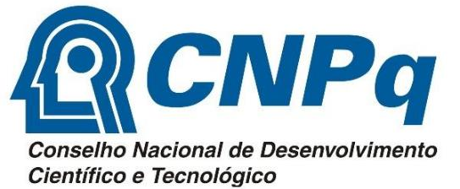
Ant mitophylogenomics using public data
Gabriel A. Vieira¹; Francisco Prosdocimi¹
¹ Laboratório de Genômica e Biodiversidade. Instituto de Bioquímica Médica Leopoldo de Meis, Universidade Federal do Rio de Janeiro, 21941-902, Rio de Janeiro-RJ, Brasil.
E-mail: gabriel.vieira@bioqmed.ufrj.br
Introduction
Mitochondrial genomes (mitogenomes) are widely used for phylogenetic studies. The mitogenome contains 37 genes, being 13 protein coding genes (PCGs), 22 tRNAs and 2 rRNAs. Animal mitogenomes can often be assembled using data from different sequencing strategies, such as WGS, RNA-Seq and Targeted Sequencing. Sequencing data can be freely obtained from the international public database Sequence Read Archive (SRA). Ants are good candidates for mitogenomic studies once they present sequencing data for various clades and only 35 complete mitogenomes described at the GenBank.
Material and Methods
We downloaded raw sequencing datasets for eight ant species from four genera without mitogenomic records in Genbank. The mitogenomes were assembled using the software NOVOPlasty2.7.2 and MITObim1.9, while automatic annotation was performed by MITOS Web Server. We constructed a preliminary Neighbor Joining tree with 1,000 bootstrap replicates on MEGA7 using the concatenated set of all 13 mitochondrial protein-coding genes (PCG’s) from our sequences plus every other ant mitogenome available from Genbank.
New mitogenomes:
● Complete
○ Partial
Results and Discussion
Figure 1. Ant phylogeny infered from concatenated mitochondrial PCG’s. The mitogenomes generated by this work are highlighted by circles.
We produced eight new mitogenomes (6 complete and 2 partial) from public data corresponding to 6 genera for which there were no mitogenome records prior to this work. The partial sequences contain all 37 genes and thus were used for phylogenetic inference. The resulting phylogenomic tree (Figure 1) contained 43 ant species and largely confirmed previous studies, reassuring the monophyletic status of most ant subfamilies and genera. However, the tree presents low bootstrap for some Myrmicinae nodes, as well as paraphyletic groups (Acromyrmex and Dolichoderinae). These aspects can be enhanced by: (i) adding of more mitogenomes and (ii) using other methodologies (e.g. Maximum Likelihood) in our analyses. Thus, these are the two next aims of this project.
Conclusion
In this study, we have assembled 8 mitogenomes from public data and used them to generate robust phyologenies. This demonstrates that advances on molecular evolutionary studies can be achieved without the need to spend increasingly precious resources on sequencing.
Acknowledgements
We thank CNPq and FAPERJ for funding our work.

